Slide 1
Lecture 16:
Permutations & Combinations
Section 6.3 + 6.5

Slide 2
Section Summary
Permutations
Combinations
Permutations with Repetitions
Combinations with Repetitions

Slide 3
Permutations
Definition: A permutation of a set of distinct objects is an ordered arrangement of these objects. An ordered arrangement of r elements of a set is called an r-permutation.
Example: Let S = {1,2,3}.
  The ordered arrangement 3,1,2 is a permutation of S.
  The ordered arrangement 3,2 is a 2-permutation of S.
The number of r-permutations of a set with n elements is denoted by P(n,r).
  The 2-permutations of S = {1,2,3} are 1,2; 1,3; 2,1; 2,3; 3,1; and 3,2. Hence, P(3,2) = 6.

Slide 4
Solving Counting Problems by Counting Permutations (continued)
Example: Suppose that a saleswoman has to visit eight different cities. She must begin her trip in a specified city, but she can visit the other seven cities in any order she wishes. How many possible orders can the saleswoman use when visiting these cities?
Solution: The first city is chosen, and the rest are ordered arbitrarily. Hence the orders are:
7! = 7 ∙ 6 ∙ 5 ∙ 4 ∙ 3 ∙ 2 ∙ 1 = 5040
If she wants to find the tour with the shortest path that visits all the cities, she must consider 5040 paths!

Slide 5
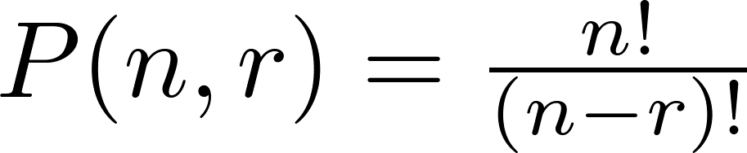
A Formula for the Number of Permutations
Theorem: If n is a positive integer and r is an integer with 1 ≤ r ≤ n, then there are
P(n, r) = n(n − 1)(n − 2) ∙∙∙ (n − r + 1)
r-permutations of a set with n distinct elements.
Proof: Use the product rule. The first element can be chosen in n ways. The second in n − 1 ways, and so on until there are (n − ( r − 1)) ways to choose the last element.
Note that P(n, 0) = 1, since there is only one way to order zero elements.
Corollary: If n and r are integers with 1 ≤ r ≤ n, then

Slide 6
Solving Counting Problems by Counting Permutations
Example: How many ways are there to select a first-prize winner, a second prize winner, and a third-prize winner from 100 different people who have entered a contest?
Solution:
P(100,3) = 100 ∙ 99 ∙ 98 = 970,200

Slide 7
Solving Counting Problems by Counting Permutations (continued)
Example: How many permutations of the letters ABCDEFGH contain the string ABC ?
Solution: We solve this problem by counting the permutations of six objects, ABC, D, E, F, G, and H.
P(6, 6) = 6! = 6 ∙ 5 ∙ 4 ∙ 3 ∙ 2 ∙ 1 = 720

Slide 8

Combinations
Definition: An r-combination of elements of a set is an unordered selection of r elements from the set. Thus, an r-combination is simply a subset of the set with r elements.
The number of r-combinations of a set with n distinct elements is denoted by C(n, r). The notation is also used and is called a binomial coefficient.
Example: Let S be the set {a, b, c, d}. Then {a, c, d} is a 3-combination from S. It is the same as {d, c, a} since the order listed does not matter.
C(4,2) = 6 because the 2-combinations of {a, b, c, d} are the six subsets {a, b}, {a, c}, {a, d}, {b, c}, {b, d}, and {c, d}.

Slide 9
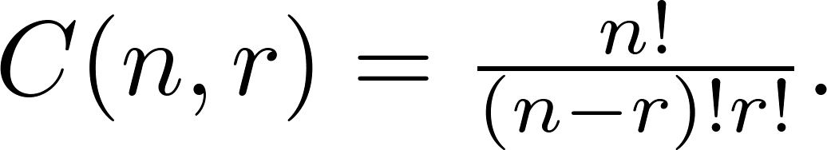
Combinations
Theorem: The number of r-combinations of a set with n elements, where n ≥ r ≥ 0, equals
Proof: By the product rule P(n, r) = C(n,r) ∙ P(r,r). Therefore,

Slide 10
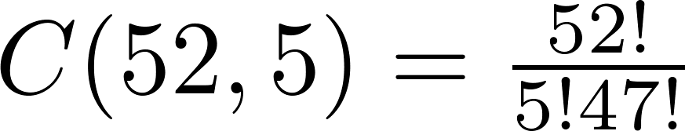
Combinations
Example: How many poker hands of five cards can be dealt from a standard deck of 52 cards? Also, how many ways are there to select 47 cards from a deck of 52 cards?
Solution: Since the order in which the cards are dealt does not matter, the number of five card hands is:
The different ways to select 47 cards from 52 is
This is a special case of a general result. →

Slide 11
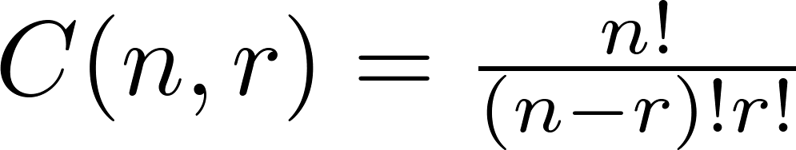
Combinations
Corollary: Let n and r be nonnegative integers with
r ≤ n. Then C(n, r) = C(n, n − r).
Proof: From Theorem 2, it follows that
and
Hence, C(n, r) = C(n, n − r).
This result can be proved without using algebraic manipulation. →

Slide 12
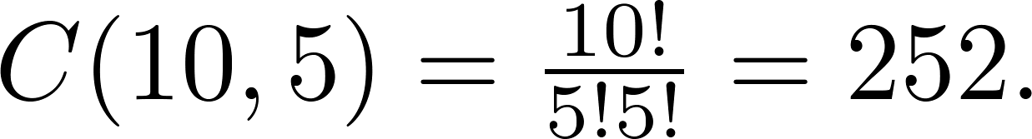
Combinations
Example: How many ways are there to select five players from a 10-member tennis team to make a trip to a match at another school.
Solution: The number of combinations is
Example: A group of 30 people have been trained as astronauts to go on the first mission to Mars. How many ways are there to select a crew of six people to go on this mission?
Solution: The number of possible crews is

Slide 13
Permutations with Repetition
Theorem: The number of r-permutations of a set of n objects with repetition allowed is n^{r}.
Proof: There are n ways to select an element of the set for each of the r positions in the r-permutation when repetition is allowed. Hence, by the product rule there are n^{r} r-permutations with repetition.
Example: How many strings of length r can be formed from the uppercase letters of the English alphabet?
Solution: The number of such strings is 26^{r}, which is the number of r-permutations of a set with 26 elements.

Slide 14
Dealing with Constraints
Example: How many bit strings of length 10 contain
a) exactly 4 1s? b) At most 3 1s?
a) Solution: To create a bit string with exactly 4 ones, we need to choose 4 positions out of the 10 for the 1s, while the remaining 6 positions will automatically be 0s.
The number of ways to choose 4 positions out of 10 is: C(10, 4) = 210.
b) Solution: We need to consider multiple cases:
Case 1: Exactly 0 ones: This corresponds to a string where all 10 bits are 0.
There is only 1 such string.
Case 2: Exactly 1 one: Choose 1 position for the 1 out of 10.
The number of ways is: C(10, 1)=10
Case 3: Exactly 2 ones: Choose 2 positions for the 1s out of 10.
The number of ways is: C(10, 2)=45
Case 4: Exactly 3 ones: Choose 3 positions for the 1s out of 10.
The number of ways is: C(10, 3)=120
Total: Now, we use the sum rule for all these values: 1+10+45+120=176

Slide 15
Dealing with Constraints
Example: 7 female and 9 male faculties are there in the mathematics department of a school. How many ways are there to select a committee of 5 members from the department if at least 1 female faculty is a must on the committee?
Solution: The total number of faculty members is 7 female and 9 male, for a total of 7+9=16. The number of ways to choose 5 members from 16 = C(16,5) = 4368.
Now we need to subtract the number of committees that contain no female, or committees that contain only male. Since there are 9 male, the number of ways to choose 5 members from 9 = C(9, 5) = 126.
Committees with at least 1 female = 4368−126 = 4242.

Slide 16
Dealing with Constraints
Example: How many strings of 6 lowercase letters of the
English alphabet contain exactly 2 vowels?
Solution: First, we choose 2 positions for the vowels. The number of ways to do this is: C(6,2) = 15.
Each vowel position can be filled with any of the 5 vowels. Therefore, there are: 5² = 25 ways to choose the 2 vowels.
The remaining 4 positions must be filled with consonants. Each position can be filled with any of the 21 consonants, so there are: 21⁴ = 194 481 ways to choose the 4 consonants.
Finally, we apply product rule to get number of all the strings. Total strings =15×25×194 481 = 72 930 375

Slide 17
Permutations with Indistinguishable Objects
Example: How many different strings can be made by reordering the letters of the word SUCCESS.
Solution: There are seven possible positions for the three Ss, two Cs, one U, and one E.
  The three Ss can be placed in C(7,3) different ways, leaving four positions free.
  The two Cs can be placed in C(4,2) different ways, leaving two positions free.
  The U can be placed in C(2,1) different ways, leaving one position free.
  The E can be placed in C(1,1) way.
By the product rule, the number of different strings is:

